Slide 1
STAT628 : Yelp Dataset
Taco Business Analysis
Group 20: YUANHAO GENG, XUELAN QIAN, ZHANPENG XU, XINYU LI

Slide 2
Introduction
Focus
Taco Restaurants
Main Goal
Aid to select the type of sauce and dish of tacos as well as the service and environment that attribute to higher ratings on yelp.
Find the main attributes of a taco restaurant that related to higher ratings.
Dataset
A subset of Yelp's businesses, reviews, tips and user data

Slide 3
Overall Data Preparation
Business data
Selected those businesses with Taco, Tacos, taco, or tacos in the business name
Created two types of variables: attributes and business time (one-hot encoding and exclude those with one or more missing values)
Impute the missing value within each type with mode

Slide 4
Review Data
Extracted related reviews by matching the business_id from business data with business_id from review data.
Standardized rating star: apply z-score and use the percentile of the z-score to get new rating stars.
Created a list of words features

Slide 5
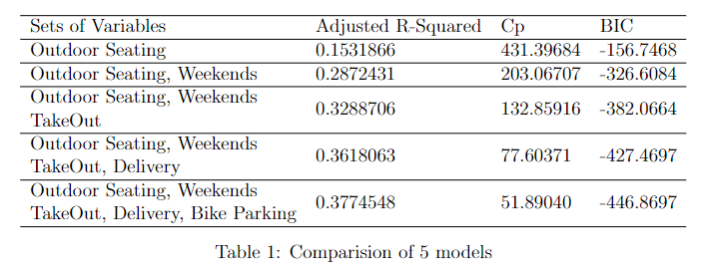
Part 1: Linear Regression Analysis on Business Data
Variable Selection
No more than 5 variables for simplicity of explanation
All subsets regression (model size from 1-5) and three metrics: Adjusted R-Squared, Cp, BIC

Slide 6
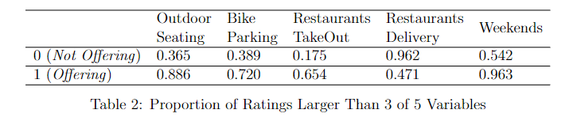
Exploratory Data Analysis
The proportion of good ratings with and without the 5 features

Slide 7
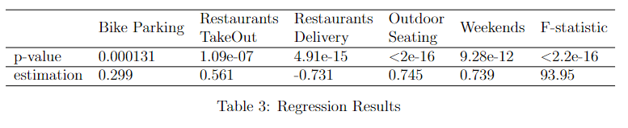
Linear Regression Model
Model
Result :
Recommendations
Provide services like Bike Parking, Restaurants TakeOut, Outdoor Seating to customers, and run business on weekends.
Avoid delivering tacos to customers.

Slide 8
Part 2: Sentiment Analysis on Review Data
Computing sentiment scores
Assign -2 to 2 scores for 1 star to 5 star
Compute average scores for each sentimental word
Compute the score of words from four main aspects
search times that phrase (e.g. shrimp+good, shrimp+bad) appears in each sentence
average the score by the number of reviews
Get the average scores of the four main aspects.

Slide 9
Recommendation
The recommendation is given by comparison the scores
For example, suppose we have the following score table for Taco Bell
The Dish may need some improvements.
The Environment of the Taco Bell should be praised.
Dish | Sauce | Service | Environment
0.2 | 0.4 | 0.5 | 0.6

Slide 10
More Detailed Recommendation
We can also provide more detailed recommendations
Continuing our previous example, we can give more specific recommendations:
Suppose in the dishes aspects, beef has the lowest score
Some guests are complaining that your beef is not good.
2. Suppose in the environment aspects, view has the highest score
People are having great experience given your nice view!

Slide 11
Web-based Application
https://stat628-module3-group20-yelp.streamlit.app/

